Slide 1



Professional Curiosity

Slide 2
What is professional Curiosity?
It’s a combination of looking, listening, asking direct
questions, checking out and reflecting on information received.
Obtaining multiple sources of information and not accepting a single set of details you are given at face value
Having an awareness of your own personal bias and how that affects how you see those you are working with
Being respectively nosey
Testing out your professional hypothesis and not making assumptions
Cross referencing information from different sources to gain a better understanding of individuals and family lived experience / past history.

Slide 3

Why is it important?
A lack of professional curiosity can lead to:
missed opportunities to identify less obvious indicators of vulnerability or significant harm
assumptions made in assessments of needs and risk which are incorrect and lead to wrong intervention for individuals and families

Slide 4

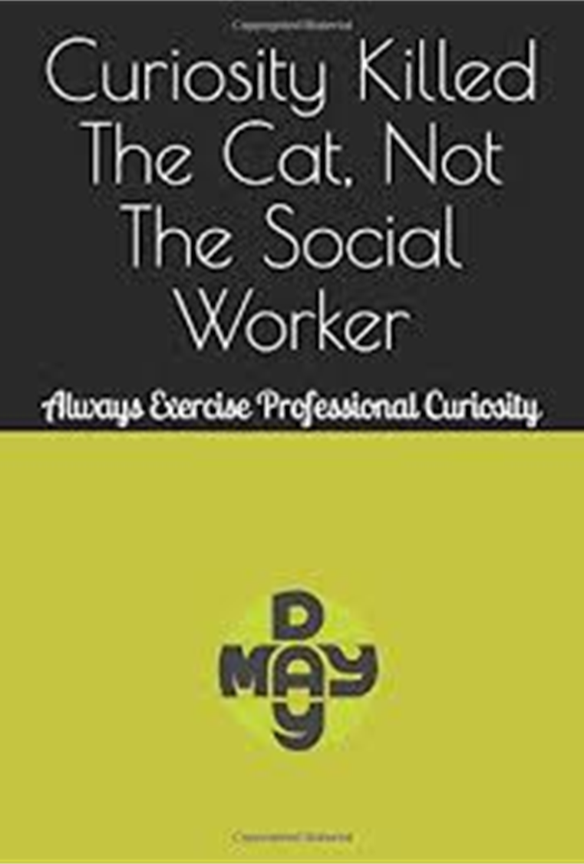
What do you see?
Is there anything about what you see when you meet with this child/adult/family which prompts questions or makes you feel uneasy?
Are you observing any behaviour which is indicative of abuse or neglect?
Does what you see support or contradict what you’re being told?

Slide 5

What do you hear?
Are you being told anything which needs further clarification?
Are you concerned about what you hear family members say to each other?
Is someone in this family trying to tell you something but is finding it difficult to express themselves? If so, how can you help them to do so?

Slide 6

Ask relevant questions
Are there direct questions you could ask when you meet this child/adult/family which will provide more information about the vulnerability of individual family members?
Here are some examples
How do you spend a typical day?
How did you get that injury?
Who do you live with?
Who is this with you?
When were you last happy?
When do you feel safe?
What do you look forward to?

Slide 7

TOP TIPS
Are other professionals involved?
Do other professionals have the same concerns?
Are they being told the same or different things?
Are others concerned?
If so, what action has been taken so far?
Is there anything else which should or could be done by you or anyone else?

Slide 8

Question your own assumptions about
how individuals/families function and
watch out for over optimism
Recognise your own feelings (for
example tiredness, stress or
illness) and how this might impact on
your view of a child/adult/family on a
given day
Think about why someone may not be
telling you the whole truth
Remember to:

Slide 9


Demonstrate a willingness to have challenging conversations
Address any professional anxiety about how hostile, resistant individual families might react to being asked direct or difficult questions
Remain open minded and expect the unexpected
Appreciate that respectful skepticism / nosiness and challenge are healthy. It is good practice and ok to question what you are told

Slide 10

Also…….
Recognise when individuals/adults repeatedly do not do what they said they would and discuss with them
Understand the cumulative impact of multiple or combined risk factors, e.g. domestic abuse, drug/alcohol misuse, mental health
Ensure that your practice is reflective and that you have access to good quality supervision

Slide 11
Professional Curiosity - In Summary
Engage people through conversations, questions, what you see
Enquire about significant people
What are the areas for concern ie DA, Neglect, Mental, Physical Health,
Poverty, Addiction
Remember to:
Verify information
Ask relevant questions
Be cautious when making judgements
Be non-judgemental and anti-discriminatory
Be brave and ready to have difficult conversations

Slide 12

Thank you for listening!
Acknowledgement: thank you to Waltham Forest Strategic Partnerships for the use of their resources
Bensound.com – royalty free music

