Slide 1
Welcome to Skills South Tyneside
Ofsted Readiness
2021/2022

Slide 2
Aim | Outcomes
For providers to have a better understanding of Ofsted Readiness in Further Education | Explain Skills South Tyneside expectations for providers in the event of an Ofsted Inspection of the service
 | Discuss and understand preparations for an Ofsted Inspection in the FE sector

Slide 3

Ofsted Inspection Overview
Ofsted is the Office for Standards in Education, Children’s Services and Skills. They inspect services providing education and skills for learners of all ages.
During an inspection, inspectors will collect information about staff and learners by talking to them, by looking at documents, records and survey responses and other recorded information and by observing everyday life at the provider.
Inspectors may also meet with employers where appropriate.
Ofsted uses this information to prepare its report and provide a grade to the inspected service

Slide 4

Ofsted Experiences

Slide 5

Education Inspection Framework (EIF)
Overall effectiveness- Provides main grading
Effectiveness of leadership and management
Quality of teaching, learning and assessment (The 3 I’s)
Personal development
Behaviour and attitudes
Safeguarding Effectiveness
Grade 1- Outstanding
Grade 2- Good
Grade 3- Requires Improvement
Grade 4- Inadequate
Her Majesty’s Chief Inspector
Amanda Spielman

Slide 6
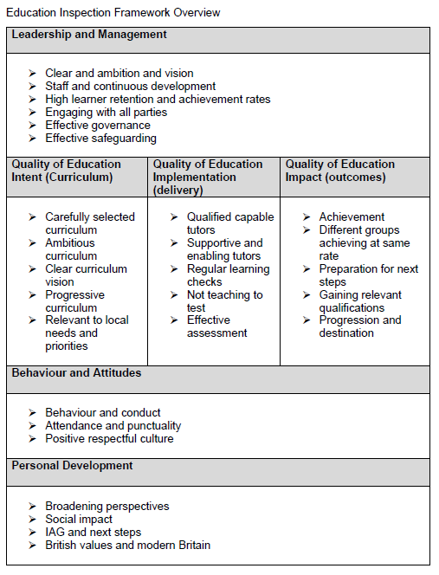
Notes:
Skills, Paul Joyce, says the new framework is “a refocusing of inspection, rather than a radical change”.
Under the new format, Joyce says: “Inspectors will be spending less time looking at performance data, and more time considering how providers are making sure their learners are developing the knowledge, skills and behaviours required to allow them to successfully progress and achieve.”
The overarching objective of the revised inspection framework is to increase the quality and consistency of education throughout England.

Slide 7

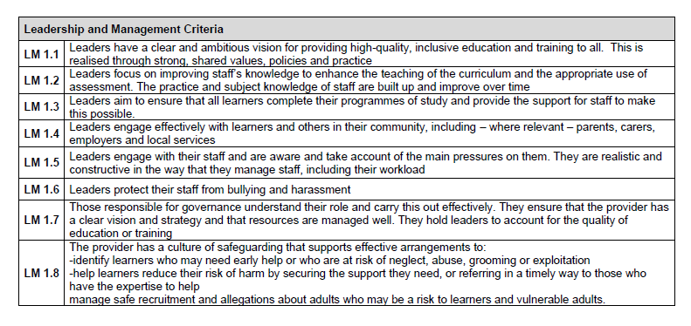

Slide 8

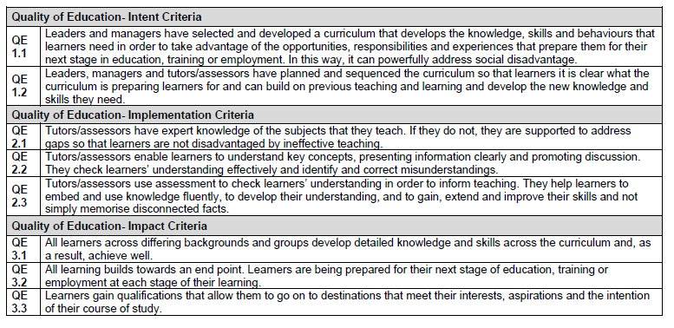

Slide 9

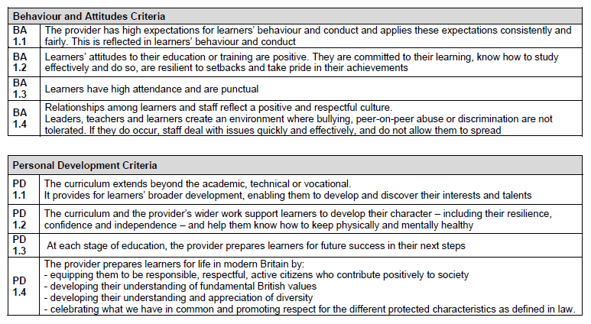

Slide 10


Inspecting during a Pandemic
As with our practice before the pandemic, Ofsted will continue to carry out some elements of the inspection or monitoring visit using video or telephone calls, where that is the most effective means of gathering information. They may use these calls to involve staff, learners, employers, those responsible for governance, subcontractors and others.
Covid-19
Leadership and Management
Inspectors will seek to understand how leaders have adapted their development plans as a result of the COVID-19 pandemic, including the rationale for any new or modified improvement priorities.

Slide 11

Covid-19
Quality of Education
Inspectors recognise that providers may have been unable to implement the curriculum in the usual way during the COVID-19 pandemic. They will seek to understand how leaders and managers have adapted and prioritised the curriculum.
This will include exploring how the provider implemented the curriculum remotely.
Inspectors will also look at how managers and staff have been identifying learning gaps and any new starting points of learners and how managers and staff have been responding to that in their curriculum planning.

Slide 12

Covid-19
Personal Development
When forming judgements about personal development, inspectors will seek to understand what took place before the pandemic, what the provider has in place currently and what its future plans are.
Inspectors recognise that many elements of personal development that were in place before the pandemic may have been disrupted. Therefore, they will focus on understanding the steps that leaders have taken to offer or to restore a wide range of personal development opportunities.

Slide 13

Covid-19
Safeguarding
Inspectors will consider how leaders and managers adapted approaches to safeguarding during the pandemic to make sure that:
  vulnerable learners were prioritised for face-to-face education as necessary
  safeguarding procedures remained effective for those receiving remote education, as well as those attending the provider
Inspectors will discuss how safeguarding arrangements have changed over time due to the pandemic, and how leaders and managers have made sure that they remain effective.

Slide 14
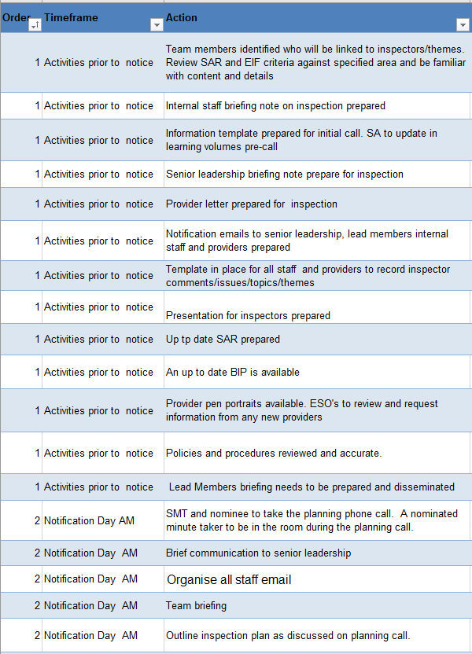
48 Hour Plan

Slide 15
Introductory conversations
Inspection
OFSTED DEEP DIVE
Learners Lesson Visits Senior Leaders
Tutors/Assessors Work Scrutiny Data
Bringing it together
Connecting evidence to reach a judgment
Grading and report
Notes:
https://thirdspacelearning.com/blog/ofsted-deep-dive-questions/

Slide 16
To ensure that the lead inspector has a clear understanding of the scope and range of provision and information needed to plan the logistics of the inspection, the nominee will send the following information, as applicable, as soon as possible:
details of the courses/programmes being delivered and their mode of delivery, including through remote and/or online delivery
timetables for lessons/sessions/lectures/seminars/workshops or other learning activities during the week
a list of provider staff and a diagram of the organisational structure
the geographical spread of training premises and learners, particularly work-based learners and apprentices, according to regions or sub-regions
the names and location of employers
the names and location of subcontractors
contact information for key staff
the current number of learners in the following age groups: 14 to 16; 16 to 18; 19+the current overall number of learners (excluding apprentices) at level 1 or below, level 2, level 3 and level 4/5, by subject area
the current number of apprentices at each level, according to age groups: 16 to 18, 19 to 24, and 25+, by subject area and by apprenticeship framework or standard
the current number of learners following employability programmes and those who have attended in the previous 12 months
details of learners who are on a study programme but who are not working towards a substantial qualification
the current number of learners following traineeships and those who have attended in the previous 12 months
the current number of learners on community learning programmes and those who have attended in the previous 12 months
the current number of learners with SEND and the number of learners for whom high-needs funding is received, and their particular needs

Slide 17

Deep Dives
‘A deep dive… involves gathering evidence on the curriculum intent, implementation and impact over a sample of subjects, topics or aspects. This is done in collaboration with leaders, tutors and learners. The intent of the deep dive is to seek to interrogate and establish a coherent evidence base on the quality of education.’
Inspecting the curriculum, Ofsted
Notes:
https://cornerstoneseducation.co.uk/news/what-to-expect-from-ofsteds-subject-deep-dives/

Slide 18
Key Questions
How have you designed your curriculum?
How is your curriculum ambitious for all learners?
How does your curriculum support the Council’s priorities?
How did you safeguard learners effectively during the pandemic?
How did governance operate effectively during the pandemic?
How do you broaden learners understanding of living in modern Britain?

Slide 19
Provider Responsibilities during a Skills South Tyneside Ofsted Inspection
All information must be current and correct
SPOC must be available and communication channels must be open
Staff working on Skills South Tyneside contract must be familiar and conversant in relevant processes and practices, in relation to the contract

Slide 20

The key aim is to ensure that all staff are so steeped in the culture of the organisation that they can give examples and evidence their responses to Ofsted’s questions
=team inclusion!

Slide 21

Dear Colleague
We have been notified that our Ofsted colleagues will visit the Skills South Tyneside from 9:00am on X until close of play X
We would also ask that you ensure you are prepared as follows:
Advise us immediately of any changes to planned delivery
Read the attached Supply Chain Partner Ofsted Inspection Guidance
Be prepared and organised for delivery with registers, schemes of work, lesson plans, personal learning plans and group profiles, ensuring all documents are up to date
Use the embedding key themes resources sent out to you on a monthly basis by Skills South Tyneside and prepare yourself to answer questions on PREVENT, British Values and safeguarding
Ensure posters provided by Skills South Tyneside are displayed in all classrooms
Ensure all learners have been given access to the Skills South Tyneside learner induction and Skills South Tyneside Learner Handbook
Prepare your learners particularly in relation to their understanding of the actual terms for equality, diversity, safeguarding and PREVENT, British Values
Ensure you complete the comments template attached. We will ask you to feedback if you have been involved.
Be familiar with the attached Self-Assessment Report and your own organisation Self-Assessment report

Slide 22
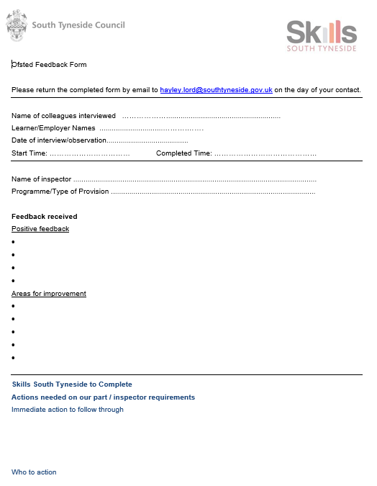

Slide 23
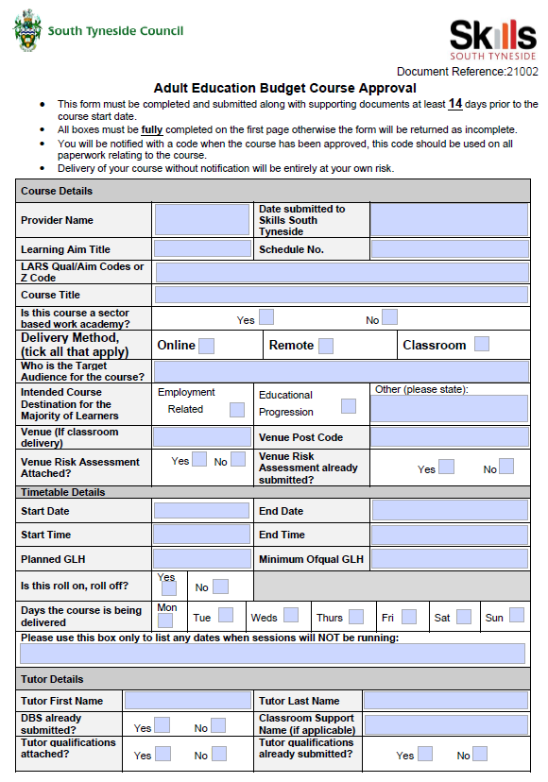

Slide 24
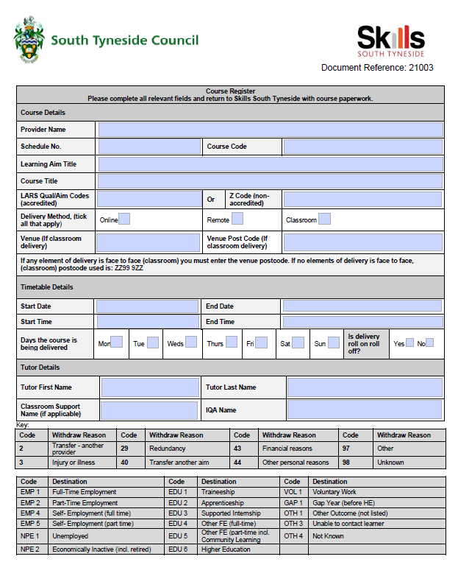

Slide 25
Planning
Ofsted has no preferred teaching style. Inspectors judge the quality of education by the ways in which learners acquire knowledge, develop skills and exhibit appropriate behaviours for work and success in life or study.
Teaching staff should plan their lessons as usual.
The curriculum
The curriculum sets out the aims of a programme of education and training. It also sets out the structure for those aims to be implemented, including the knowledge, skills and behaviours to be gained at each stage. It enables the evaluation of
learners’ knowledge and understanding
against those expectations.

Slide 26
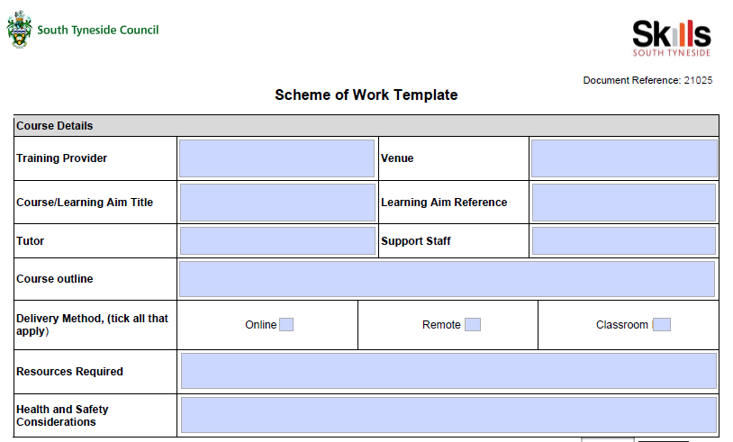
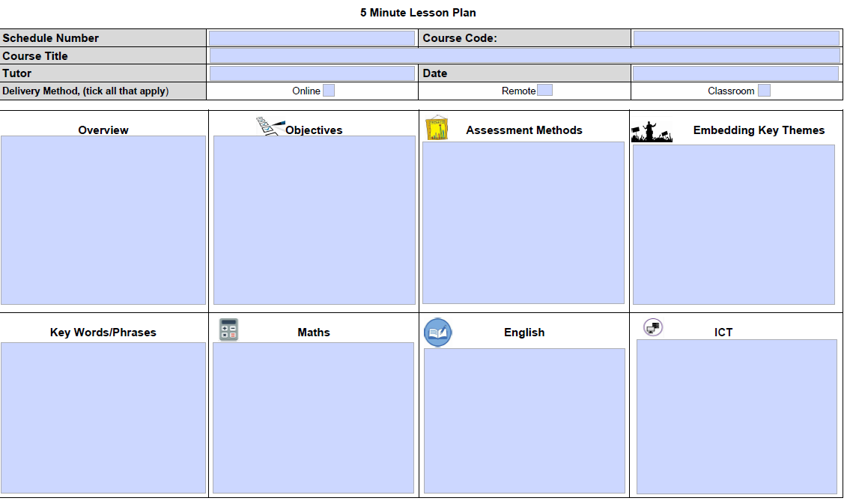

Slide 27
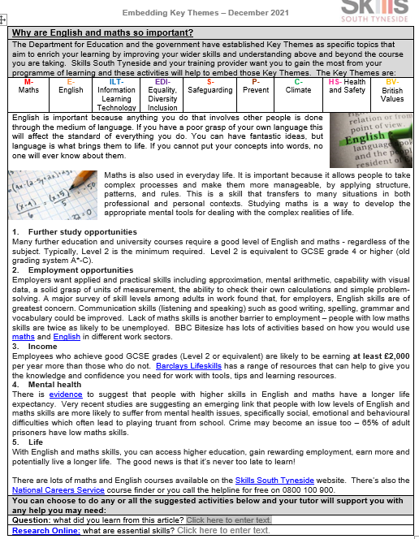
Embedding Key Themes

Slide 28


Posters

