Slide 1




Welcome to
Skills South Tyneside

Slide 2
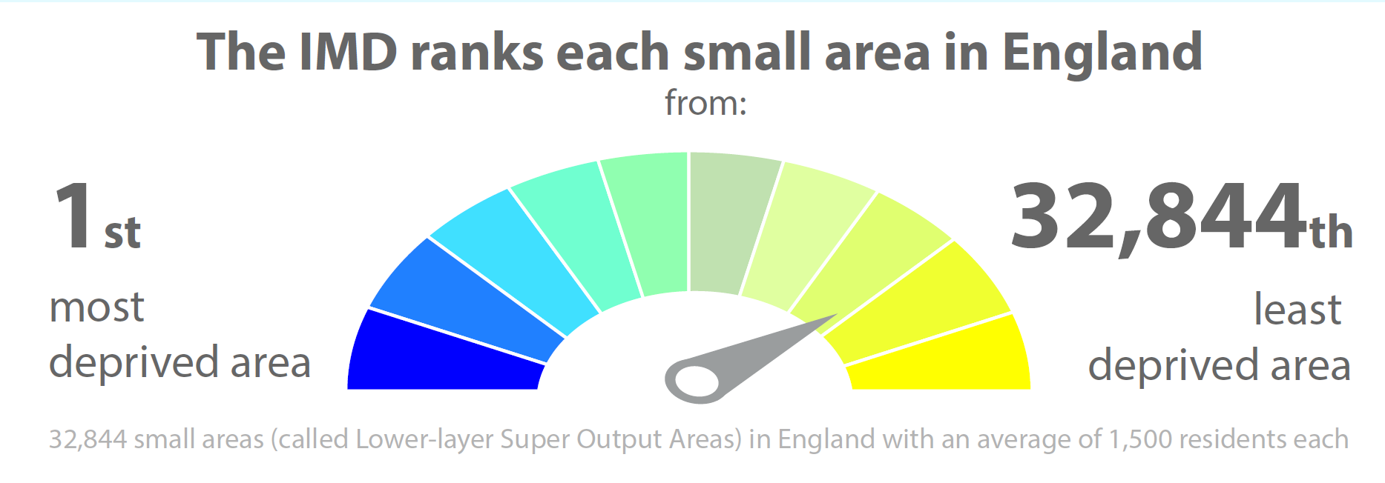
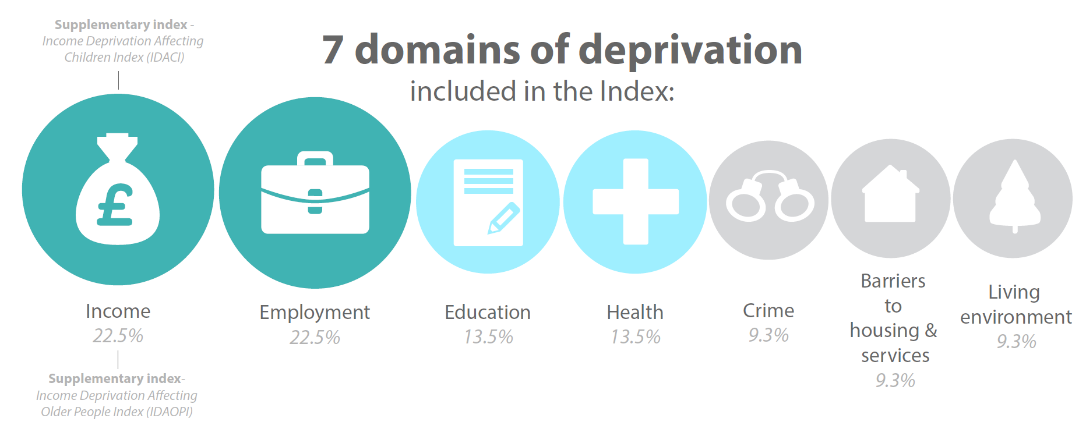
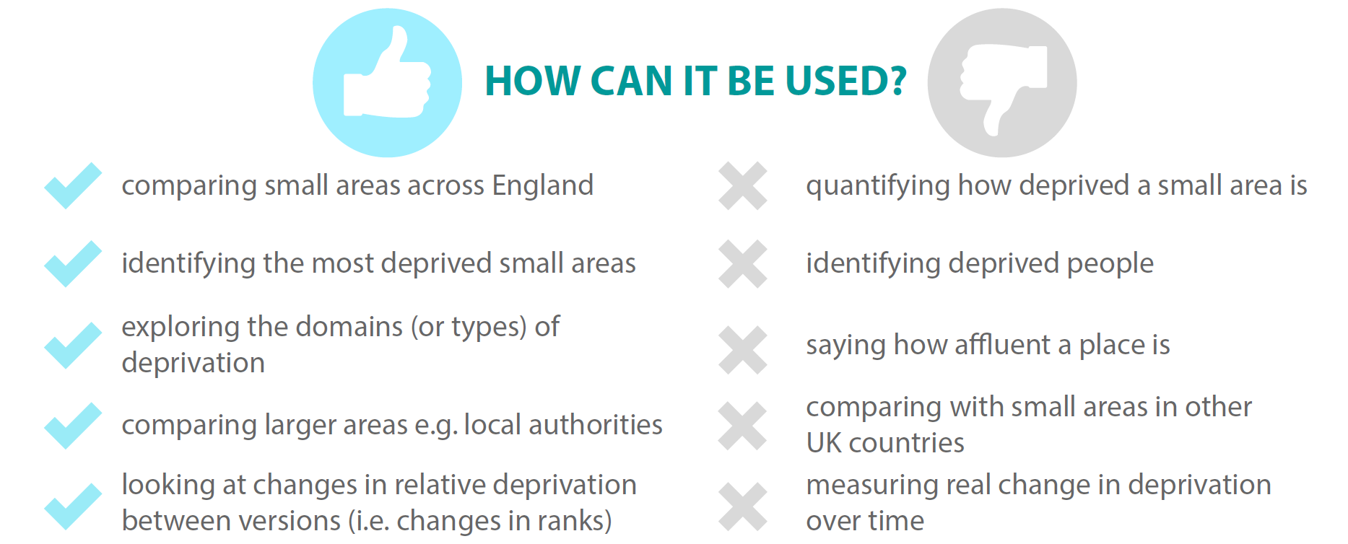

Slide 3
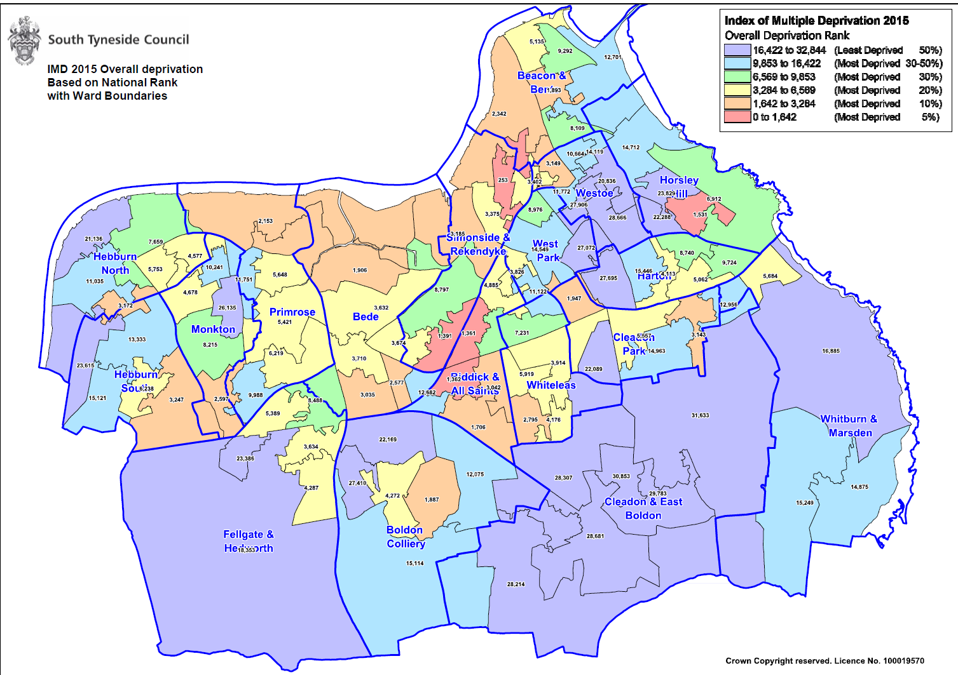

Slide 4
The largest volume of learners we supported were from the wards ranked highest in respect of deprivation factors.

Slide 5
2020-2021 Learner Destination Data
1591 learners tracked into destinations
Of those tracked learners 65% recorded a positive destination of which 54% were employment related
Positive Destinations | Learners | Percentage
New Full Time Employment (16 or more hours per week) | 299 | 29%
Retained Self Employment (16 or more hours per week) | 200 | 19%
Retained Full Time Employment (16 or more hours per week) | 167 | 16%
Part Time Further Education (including Community Learning) | 161 | 15%
Retained Part Time Employment (less than 16 hours per week) | 68 | 7%
New Part Time Employment (less than 16 hours per week) | 44 | 4%
Voluntary Work | 36 | 3%
Apprenticeship | 24 | 2%
Full Time Further Education | 13 | 1%
New Self Employment (less than 16 hours per week) | 10 | 1%
New Self Employment (16 or more hours per week) | 10 | 1%
Other - detail required in further details column | 6 | 1%
Retained Self Employment (less than 16 hours per week) | 4 | 0%
Higher Education | 4 | 0%

Slide 6
2020-2021 Learner Destination Data
545 learners reported destinations which were not employment or educationally related (negative destinations)
212 learners were not tracked
Why do I have to send this information?
This is part of your contract with South Tyneside Council (please see Appendix 8 paragraph 8.8 of your contract). Please note that destination tracking is compulsory for all learners.
What if I don’t send my data by the due date?
South Tyneside Council reserves the right to suspend payments if you miss the due date for a return, please see Appendix 8 paragraph 8.9 of your contract.
Negative Destination | Number of Learners | Percentage
Unemployed, looking for work and available to start work | 323 | 59%
Unable to contact | 168 | 31%
Not available for work (including retired) | 42 | 8%
Other | 12 | 2%

Slide 7
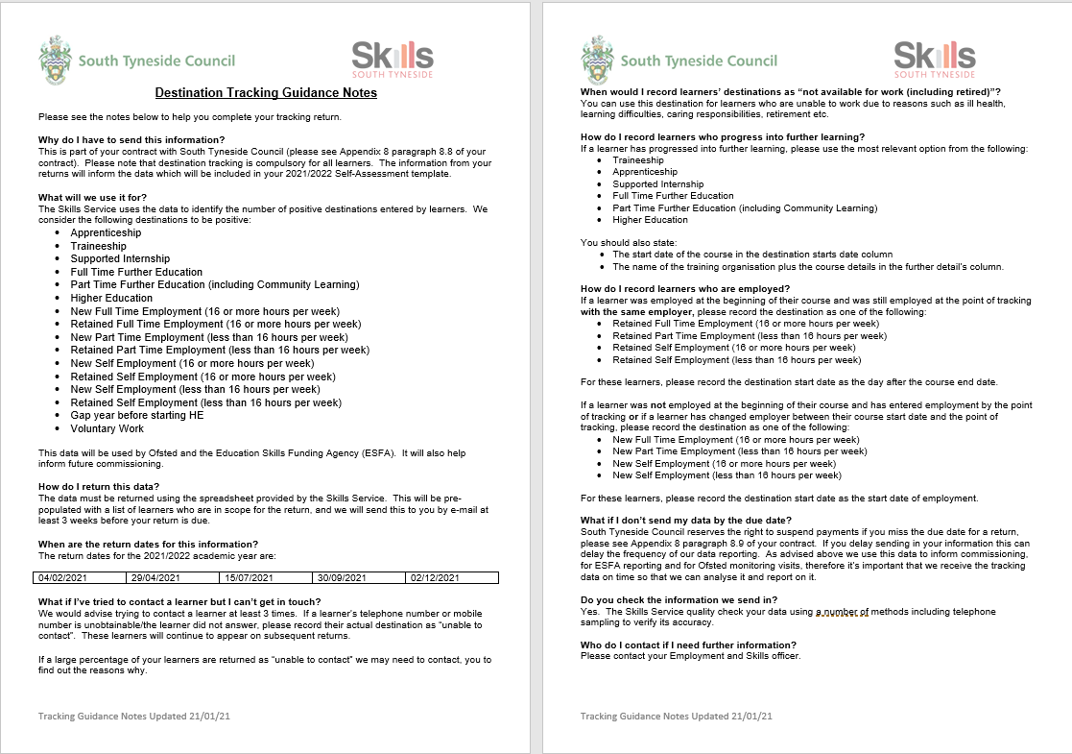
Quarter 1 04/02/2022 | Quarter 2 29/04/2022 | Quarter 3 15/07/2022 | Quarter 4 30/09/2022 | Final Return 02/12/2022

